Slide 1
SMART PARKING SYSTEM USING IOT
R.MONIKA

Slide 2
Project Definition
The Smart Parking System project intends to create a cutting-edge solution to address the difficulties in managing urban parking. This system makes use of cutting-edge technologies to maximize the availability of parking, improve user experience, and boost traffic flow in metropolitan settings.

Slide 3
Project Objectives
User friendly Mobile app
Parking space Optimization
Payment and billing Integration
Sensor integration
Data Analytics and Reporting
Traffic Flow Improvement
Accessibility and Safety
Public Awareness

Slide 4
IOT Sensor Design
Sensor selection
Power Source
Communication Module
Microcontroller
Enclosure
Mounting and Installations
Data processing
Data Transmission
Power management
Security measures
Calibration and maintenance
Scalability
User interface
Testing and validation
Integration with central system
Data retention

Slide 5
Real time Transit information Platform
Landing page
User Registration/Login
Home screen
Parking facility details
Number of available places
Pricing details
Hours of operation
Navigation
Notifications
Users rating and reviews
Security
Help and FAQ
Direction to the facility
Reservation option

Slide 6
Integration Approach
Hardware Setup
Select sensor
Connect sensor
Power supply
Protective enclosure
Software Setup
Operating system
Sensor data Processing
Server application
API development

Slide 7
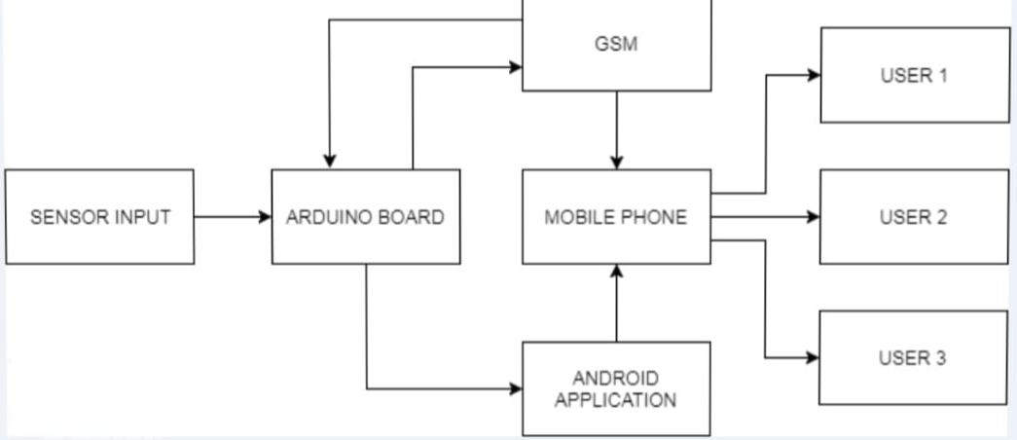
BLOCK DIAGRAM

Slide 8
SENSORS
IR SENSOR
. An infrared sensor is basically an electronic device which is used to detect the presence of objects. Infrared light is emitted by this device. If this device does not detect any IR light reflected back that means there is no object present. If the light is detected by the sensor there is an object present.
ULTROSONIC SENSOR
These are placed in parking spaces to detect the presence of a vehicle. They send signals and measure the time it takes for the signals to bounce back, determining if a space is occupied.

Slide 9
ARDUINO BOARD
Acts as the brain of the system, processing information from the sensors. It makes decisions based on the sensor data, such as whether a parking space is occupied.
It is a compact board which can be used in various devices and various field. It has overall 22 input/output pins out of which 14 pins are digital pins. It has a flash memory of about 32 kb. These pins can control the operations of digital pins as well as analogy pins.
This module is a breadboard-friendly board which can be easily used anywhere.

Slide 10
GSM MODULE
The GSM module is a circuit which is used to setup communication between mobile phones and Arduino. It is used to send SMS, MMS and voice messages through mobile network. GPRS extension in GSM allows high data transmission. GSM uses time division multiple access approach for transmission
The system has successfully been applied to GSM network in parking management technology, which makes parking much easier for drivers. A short message could be sent to the system to realize parking easily. The system has several advantages, such as high efficiency, low cost, high security and automatic.

Slide 11
Import colorama from termcolor import colored options_message = “”” Choose: 1. To park a vehicle 2. To remove a vehicle from parking 3. Show parking layout 4. Exit

Slide 12
class Vehicle:
def _init_(self, v_type, v_number):
self.v_type = v_type
self.v_number = v_number
self.vehicle_types = {1: 'c', 2: 'b', 3: 't'}
def _str_(self):
return self.vehicle_types[self.v_type]
class Slot:
def _init_(self):
self.vehicle = None
class Parking: def _init_(self, rows, columns): self.rows = rows self.columns = columns self.slots = self._get_slots(rows, columns)

Slide 13
def start(self):
while True:
try:
print(options_message)
option = input("Enter your choice: ")
if option == '1':
self._park_vehicle()
if option == '2':
self._remove_vehicle()
if option == '3':
self.show_layout()
if option == '4':
break

Slide 14
except ValueError as e:
print(colored(f"An error occurred: {e}. Try again.", "red"))
print(colored("Thanks for using our parking assistance system", "green"))
def _park_vehicle(self):
vehicle_type = self._get_safe_int("Available vehicle types: 1. Car\t2. Bike\t3. Truck.\nEnter your choice: ")
if vehicle_type not in [1, 2, 3]:
raise ValueError("Invalid vehicle type specified")
vehicle_number = input("Enter vehicle name plate: ")
if not vehicle_number:
raise ValueError("Vehicle name plate cannot be empty.")
vehicle = Vehicle(vehicle_type, vehicle_number)
print('\n')
print(colored(f"Slots available: {self._get_slot_count()}\n", "yellow"))
self.show_layout()
print('\n')

Slide 15
col = self._get_safe_int("Enter the column where you want to park the vehicle: ")
if col <= 0 or col > self.columns:
raise ValueError("Invalid row or column number specified")
row = self._get_safe_int("Enter the row where you want to park the vehicle: ")
if row <= 0 or row > self.rows:
raise ValueError("Invalid row number specified")

Slide 16
slot = self.slots[row-1][col-1]
if not slot.is_empty:
raise ValueError("Slot is not empty. Please choose an empty slot.")
slot.vehicle = vehicle
def _remove_vehicle(self):
vehicle_number = input("Enter the vehicle number that needs to be removed from parking slot: ")
if not vehicle_number:
raise ValueError("Vehicle number is required.")

Slide 17
def show_layout(self):
col_info = [f'<{col}>' for col in range(1, self.columns + 1)]
print(colored(f"|{''.join(col_info)}|columns", "yellow"))
self._print_border(text="rows")
for i, row in enumerate(self.slots, 1):
string_to_printed = "|"
for j, col in enumerate(row, 1):
string_to_printed += colored(f"[{col.vehicle if col.vehicle else ' '}]",
"red" if col.vehicle else "green")
string_to_printed += colored(f"|<{i}>", "cyan")
print(string_to_printed)
self._print_border()

Slide 18
def _print_border(self, text=""):
print(colored(f"|{'-' * self.columns * 3}|{colored(text, 'cyan')}", "blue"))
def _get_slot_count(self):
count = 0
for row in self.slots:
for slot in row:
if slot.is_empty:
count += 1
return count

Slide 19
@staticmethod
def _get_slots(rows, columns):
slots = []
for row in range(0, rows):
col_slot = []
for col in range(0, columns):
col_slot.append(Slot())
slots.append(col_slot)
return slots

Slide 20
def main():
try:
print(colored("Welcome to the parking assistance system.", "green"))
print(colored("First let's setup the parking system", "yellow"))
rows = int(input("Enter the number of rows: "))
columns = int(input("Enter the number of columns: "))
print("Initializing parking")
parking = Parking(rows, columns)
parking.start()
except ValueError:
print("Rows and columns should be integers only.")
except Exception as e:
print(colored(f"An error occurred: {e}", "red"))

